Slide 1
Autoencoder

Slide 2
Unsupervised Learning
Process of learning from a data without its corresponding label.
Application:
Finding hidden structures in data
Data compression
Clustering
Retrieving similar objects
Exploratory Data Analysis
Generating new examples

Slide 3
Fully-Connected (Multilayer-Perceptron) Autoencoder

Slide 4
Fully-Connected (Multilayer-Perceptron) Autoencoder

Slide 5
Autoencoder Applications
Use embedding as input to classic machine learning methods (SVM, KNN, Random Forest, ...)
Or, similar to transfer learning, train autoencoder on large image dataset, then fine tune encoder part on your own, smaller datset and/or provide your own output (classification) layer
Latent space can also be used for visualization (EDA, clustering), but there are better methods for that

Slide 6
A Simple Autoencoder

Slide 7
A Convolutional Autoencoder

Slide 8
Up-Sampling Method
Allow to increase the size of feature map from input
Up-sampling Method:
Nearest Neighbour
Bi-Linear Interpolation
Bed Of Nails
Max-Unpooling
Transposed Convolution

Slide 9
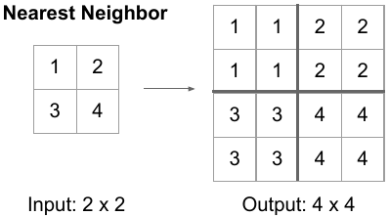
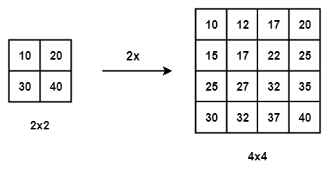
Up-Sampling Method
Bi Linear interpolation

Slide 10
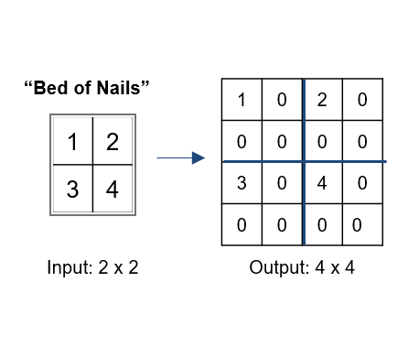
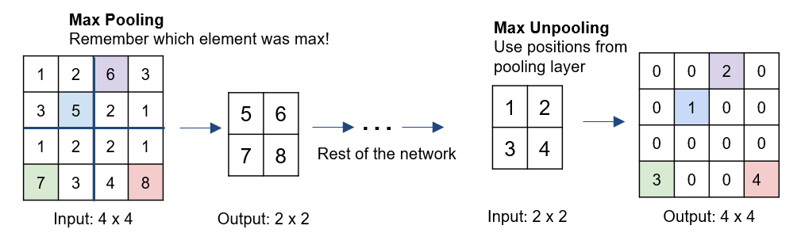
Up-Sampling Method

Slide 11
Transposed Convolution

Slide 12
Transposed Convolution

Slide 13
Transposed Convolution
strides: in transposed convolutions, we stride over the output; hence, larger strides will result in larger outputs (opposite to regular convolutions)

Slide 14
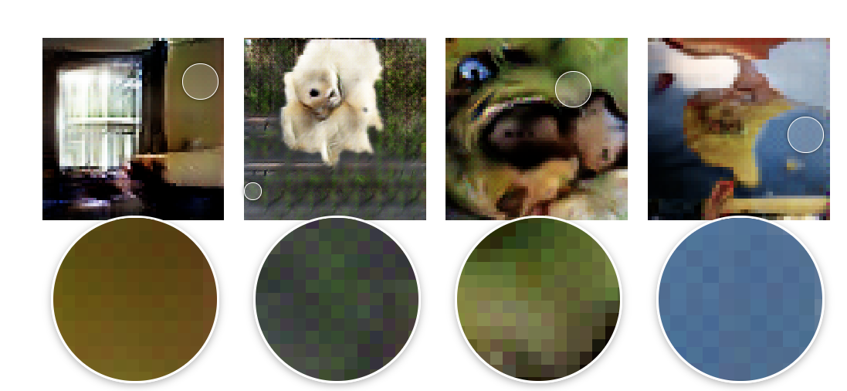
Problems with Transposed Convolutions
Transposed convolutions suffer from checkerboard effects as shown below
https://distill.pub/2016/deconv-checkerboard/

Slide 15
Problems with Transposed Convolutions
https://distill.pub/2016/deconv-checkerboard/
it is recommended to replace transposed conv. by upsampling (interpolation) followed by regular convolution

Slide 16
A Convolutional Autoencoder with Nearest Neighbor Interpolation

Slide 17
Denoising Autoencoder

Slide 18
Sparse Autoencoder

